Slide 1


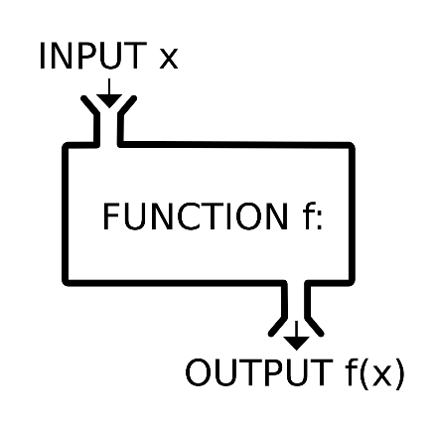
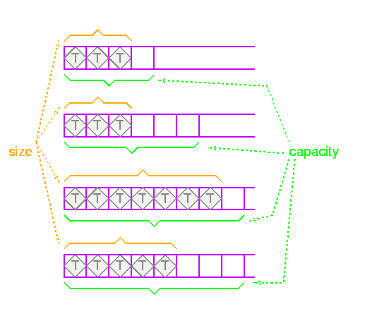

Functions, Arrays, Vectors
Creating and Using Functions, Arrays in C++, STL Vectors
Zhivko Petrov
A guy that knows C++

Slide 2

Table of Contents
Functions – Calling, Declaring, Defining
C++ Arrays
Arrays in Programming
Declaring & Initializing
Usage with Functions
STL Vectors
Dynamic-size arrays
Using std::vector

Slide 3
Questions
sli.do #cpp-softuni

Slide 4
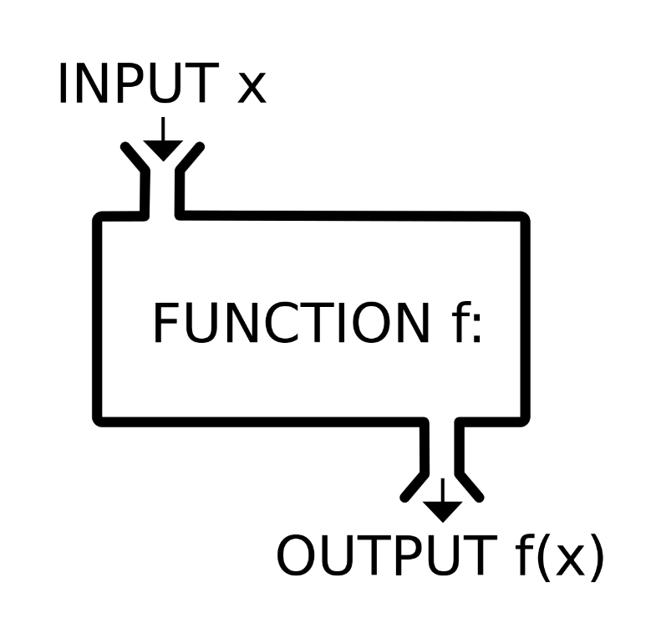
Functions
Calling, Defining, Implementing, Overloads

Slide 5
What is a Function
A named block that performs a specific task
Can be called from other code
Can take parameters and return a value
Similar to math functions like cos(α), sin(α), tan(α), etc.
All of these are actually functions you can use in C++
Also known as methods, procedures, subroutines
main() is a function

Slide 6
Calling Functions
Using functions is almost like using variables, however:
You write () after them, which could contain parameters
Most functions return a value – you can use it in an expression
Just like you would use a variable's value
void functions don't have values, they just do something
#include<iostream>
#include<cmath>
int main() {
double degrees = 60;
double radians = degrees * M_PI / 180.0;
std::cout << sin(radians) << std::endl;
std::cout << cos(radians) << std::endl;
}

Slide 7
Calling Functions
LIVE DEMO

Slide 8
Declaring and Defining Functions
Declare the function
return type (i.e. value)
name
parameters
Define the body
always in a block
contains the actual code
Call with name followed by () containing parameters
#include<iostream>
int getMax(int a, int b) {
int maxValue;
if (a > b) {
maxValue = a;
} else {
maxValue = b;
}
return maxValue;
}
int main() {
std::cout << getMax(5, 7) << std::endl;
return 0;
}

Slide 9
Declaring and Defining Functions
LIVE DEMO

Slide 10
Function Declaration
Declaration – function's name, return type and parameters
Can be separate from definition (which includes the code block)
Syntax: ReturnType functionName(parameters);
Parameters: empty, single, or several separated by , (comma)
Syntax: DataType [parameterName [= defaultValue]]
int getMax(int a, int b);
int getMax(int, int);
void printAlphabet(char start = 'a', char end = 'a');

Slide 11
Function Declaration vs. Definition
Declaration – tells the compiler there is such a function
Can be anywhere
Can appear multiple times
Same visibility rules as for variables
Definition – tells the compiler what the function does
Can be declared but not defined – compilation error if called
#include<iostream>
int getMax(int, int);
int main() {
std::cout << getMax(5, 7);
return 0;
}
int getMax(int a, int b) {
int maxValue;
if (a > b) { maxValue = a; }
else { maxValue = b; }
return maxValue;
}

Slide 12
Declaring vs. Defining Functions
LIVE DEMO

Slide 13
Parameters & Default Values
Parameters are just variables living in the function’s block
Parameters with default values can be omitted by the caller
If omitted are initialized with the default value
Must be last in the parameter list
void printAlphabet(char first = 'a', char last = 'z') {
for (char i = first; i <= last; i++) { cout << i; }
cout << endl;
}
int main() {
printAlphabet(); printAlphabet('p'); printAlphabet('p', 'x');
return 0;
}

Slide 14
Passing By Value vs. Passing By Reference
Parameters are normally copies of their originals
Changing them does NOT change the caller's variables
"Passing by value"
To access the caller's variables directly, use references
Syntax: DataType& param
"Passing by reference"
int square(int num) {
num = num * num;
return num;
}
void swap(int& a, int& b) {
int oldA = a; a = b; b = oldA;
}
int main() {
int x = 5;
std::cout << square(x); //25
std::cout << x; //5
int y = 42;
swap(x, y);
std::cout << x; //42
return 0;
}

Slide 15
Returning Values from Functions
The return keyword determines the function's return value
return immediately exits the function
Non-void functions must have a return followed by a value
int getMax(int a, int b) {
if (a > b) {
return a;
}
return b;
}

Slide 16
Parameters and Returning Values
LIVE DEMO

Slide 17
Overloaded Functions
Same function name and return type, different parameter list
Different number or types of parameters
int getMax(int a, int b) {
if (a > b) {
return a;
}
return b;
}
int getMax(int a, int b, int c) {
return getMax(a, getMax(b, c));
}

Slide 18
Overloaded Functions
LIVE DEMO

Slide 19
static Variables Inside Functions
static variables live through entire program, initialized once
static variables can be used inside functions to track state
E.g. how many times a function was called
double movingAverage(int nextNumber) {
static int count = 0;
static int sum = 0;
sum += nextNumber;
count++;
return sum / (double)count;
}

Slide 20
Static Variables Inside Functions
LIVE DEMO

Slide 21
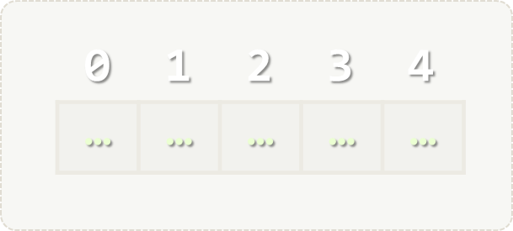
Arrays
Multiple Values Inside One Variable

Slide 22
What are Arrays?
In programming, an array is a sequence of elements
Elements are numbered from 0 to Length-1
Elements are of the same type (e.g. integers)
Arrays have fixed size – cannot be resized
0 1 2 3 4
Element index
Array of 5 elements
… | … | … | … | …
Element of an array

Slide 23
Creating C++ Arrays
Declaring: DataType identifier [arraySize];
C++ arrays have some special initialization syntax
DataType identifier[N] = {elem0, elem1, ..., elemN-1}
There can be less than N elements, but not more
N can be omitted – number of elements assumed as size
Example: int fibonacci[5] = {1, 1, 2, 3, 5};
Index | 0 | 1 | 2 | 3 | 4
Value | 1 | 1 | 2 | 3 | 5

Slide 24
C++ Array Declaration & Initialization
C++ Array size must be an integer, known compile-time
i.e. size can be a literal
or a const value/expression
C99 allows "variable-length arrays" (VLA)
Size can be a variable (still can't change size after declaration)
Some C++ compilers support VLA too
double numbers[7];
const int NumLetters = 26;
char alphabet[NumLetters];
C99
int arrSize;
cin >> arrSize;
double arr[arrSize]{};

Slide 25
C++ Array Initialization
{} initializes elements (comma-separated values)
if less values than array size -> remaining get default values
if more values than array size -> compilation error
Other rules are the same as for primitives
Statics/globals are default-initialized
Can only be initialized once
Can be made const
double values[3] = {3.14};
double sameValues[3] = {3.14, 0, 0};

Slide 26
Creating C++ Arrays
LIVE DEMO

Slide 27
Accessing Array Elements
The indexing operator [] gives access to any array element
array[index] = value; DataType value = arrayName[index]
E.g. to access the first element of arr, do arr[0]
Once you access the element, treat it as a normal variable
double point2d[2] = {};
std::cin >> point2d[0] >> point2d[1];
double distToCenter = sqrt(point2d[0] * point2d[0] + point2d[1] * point2d[1]);
point2d[0] /= distToCenter;
point2d[1] /= distToCenter;
std::cout << point2d[0] << " " << point2d[1] << std::endl;

Slide 28
Accessing Array Elements
LIVE DEMO

Slide 29
Quick Quiz
TIME:
You are John Snow. What will the following two code lines do?
cause a compile-time error
cause a runtime error due to index being out of bounds
summon demons
you know nothing
double arr[2] = {};
arr[3] = 42;

Slide 30

C++ Pitfall: Array OUT-of-Bounds Access
The C++ standard doesn’t define out-of-bounds array access behavior. C++ arrays don’t store information on their length.
Program will usually attempt to access memory even if out of the array. If that part of memory is accessible to the program, it will execute whatever it is told. Otherwise an error might happen (0xC00005 on Windows)

Slide 31
Reading-in an Array
Arrays are often read-in from some input, instead of initialized
That’s the point of arrays – to store arbitrary amounts of data
Common approach: run a loop to read-in a number of elements
Example: read-in a specified number of elements from console
int main() {
const int MaxLength = ... // the max expected input (depends on task)
int numbers[MaxLength];
int actualCount; cin >> actualCount;
for (int i = 0; i < actualCount; i++) {
cin >> numbers[i];
}
return 0;
}

Slide 32
Reading-in Arrays
LIVE DEMO

Slide 33
Writing-out an Array
You will commonly need to display all elements of an array
Common approach: loop over the elements, print each
Note: need to know how long the array is – keep a variable
const int numRoots = 100;
double squareRoots[numRoots] = {};
for (int i = 0; i < numRoots; i++) {
squareRoots[i] = sqrt(i);
}
for (int i = 0; i < numRoots; i++) {
cout << squareRoots[i] << endl;
}

Slide 34
Writing-out Arrays
LIVE DEMO

Slide 35
Arrays as Function Parameters
Array parameters are declared the same way arrays are declared
DataType name[size_0], additional [size_i] per dimension*
First dimension size can be omitted in array parameter
Usually necessary to add an int with the size
* arrays can be multi-dimensional (e.g. a 2D array is called a "matrix") – we'll cover those later on
void print(int a[], int size) {
for (int i = 0; i < size; i++) {
cout << a[i] << " ";
}
cout << endl;
}
int main() {
int numbers[] = {1,2,3};
print(numbers, 3);
return 0;
}

Slide 36
Arrays & Functions – Specifics
Functions work on the ORIGINAL array the caller uses
If the function changes an element, the caller's array is modified
You can imagine array elements are passed "by reference"
Functions CAN'T return C++ “static” arrays created in them
Arrays are essentially memory addresses
The memory they point to is freed when the function exits
We will later discuss other ways to return sequences of elements

Slide 37
C++11 Range-Based for Loop
Tired of writing for loops with indices to iterate over an array?
C++11 added a loop for that use-case
Syntax (for arrays): for (DataType element : array)
Body will execute once for each element in the array
On each iteration, element will be the next item in the array
int numbers[] = {13, 42, 69};
for (int number : numbers) {
cout << number << endl;
}

Slide 38
C++11 <array> Header
C++11 provides an alternative array, which is a bit smarter
The array class knows its size, can be returned from functions
#include<array>
Declaring: array<int, 5> arr; is the same as int arr[5];
Declaring & Initializing: array<int, 5> arr = {1, 2, 3, 4, 5};
arr.size() gives you the size of the array
Accessing elements: use the [] operator like with normal arrays

Slide 39
C++11 Range-Based for Loop and array Class
LIVE DEMO

Slide 40
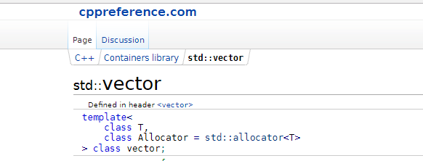
STL Vectors
C++ Dynamically-Sized Arrays

Slide 41
STL Vector Basics
The C++ std::vector class is a resizable array
Has normal array-like access – [] operator
Knows it's size (.size()), can add elements (.push_back())
#include<vector>
Acts like a normal variable
Can be assigned like a normal variable
Can be passed to a function as a value or as a reference
Can be returned from a function

Slide 42
Initializing a Vector
Declaration Syntax: std::vector<T> name;
The vector is initially empty – items need to be added
Call push_back(T element) on the vector to add elements
Can be initialized directly in C++11 with {} syntax
std::vector<int> numbers {13, 42, 69};
std::vector<double> squareRoots;
for (int i = 0; i < 100; i++) {
squareRoots.push_back(sqrt(i));
}

Slide 43
Initializing STL Vectors
LIVE DEMO

Slide 44
STL Vectors as Function Parameters
Vectors parameters are like normal variable parameters
Passed by value (copy). Can be passed by reference with &
void print(std::vector<int> nums) {
for (int i = 0; i < nums.size(); i++)
cout << numbers[i] <<" ";
cout << endl;
}
void printMultiplied(vector<int> nums,
int multiplier) {
for (int i = 0; i < nums.size(); i++)
nums[i] *= multiplier;
print(nums);
}
int main() {
vector<int> nums {1, 2, 3};
printMultiplied(nums, 10);
// 10, 20, 30
print(nums);
// 1, 2, 3
return 0;
}

Slide 45
STL Vectors as Function Parameters
LIVE DEMO

Slide 46
Returning STL Vectors from Functions
Vectors act as normal variables when returned
Function returns a copy (C++11 optimizes by "moving" memory)
vector<double> getSquareRoots(int from, int to) {
vector<double> roots;
for (int i = from; i <= to; i++) {
roots.push_back(sqrt(i));
}
return roots;
}
int main() {
print(getSquareRoots(4, 25));
return 0;
}
void print(vector<double> numbers) {
for (int number : numbers) {
cout << number << " "
}
cout << endl;
}

Slide 47
Returning STL Vectors from Functions
LIVE DEMO

Slide 48

Summary
Functions are named, reusable blocks of code
Can accept parameters and return values
Arrays are sequences of numbered elements
C++ "static" arrays are a basic language-feature
std::array is a smarter array which knows its size
std::vector is a resizable array
STL Vectors are objects that represent arrays which can resize
Act as normal variables when passed to/returned from functions
Can mostly be used instead of arrays for basic tasks

Slide 49
https://softuni.bg/trainings/courses

Slide 50












SoftUni Diamond Partners

Slide 51




SoftUni Organizational Partners

Slide 52




Trainings @ Software University (SoftUni)
Software University – High-Quality Education and Employment Opportunities
softuni.bg
Software University Foundation
http://softuni.foundation/
Software University @ Facebook
facebook.com/SoftwareUniversity
Software University Forums
forum.softuni.bg

Slide 53
License
This course (slides, examples, demos, videos, homework, etc.) is licensed under the "Creative Commons Attribution-NonCommercial-ShareAlike 4.0 International" license

